Slide 1
Schedule
This week (Week 6)
Project 1 Due on Sunday
Practical coding advice
Geometries
Next Week - March 1
Debugging and Try\Except
Final Project Proposal Due
Homework

Slide 2
Practical Coding Advice

Slide 3
Use “print” statements!
Print out things like:
Variables
Files and paths
When a process finishes
The amount of time a process takes

Slide 4
Let your compiler yell at you!
http://www.pgbovine.net/c-programming-tips.htm#compiler-warnings
When a program fails, you want it to fail loudly
Don’t use try-except statements until your code works. Try-except statements can mask the real issues.

Slide 5
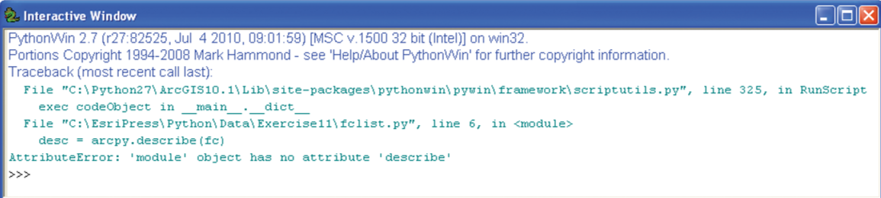
Learn to read compiler error messages
First thing to notice: what line of code the tool failed on.
From there, think about what the most likely source of error is

Slide 6
Debugging

Slide 7
Common Python Code Errors
Spelling mistakes
Forgetting to import modules
Case sensitivity
Paths
Forgetting colons (:) on if-else statements and loops
Incorrect or inconsistent indentation

Slide 8
Debugging Tips and Tricks
Remember, ArcGIS puts a lock on files that are in use
When working with large files, test code on a small sample of data
Use “print” statements ☺

Slide 9
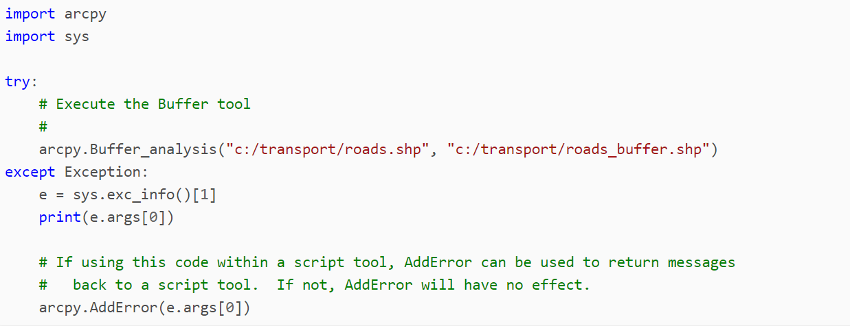
Exceptions
Try-except – Way to gracefully handle errors
http://pro.arcgis.com/en/pro-app/arcpy/get-started/error-handling-with-python.htm
If interested in learning, look at the Debugging Exercise!

Slide 10
Arcpy Geometry Objects

Slide 11
ArcPy Geometry Objects
We can perform spatial operations directly on geometries on a feature class
Buffer
DistanceTo
Clip
Contains

Slide 12
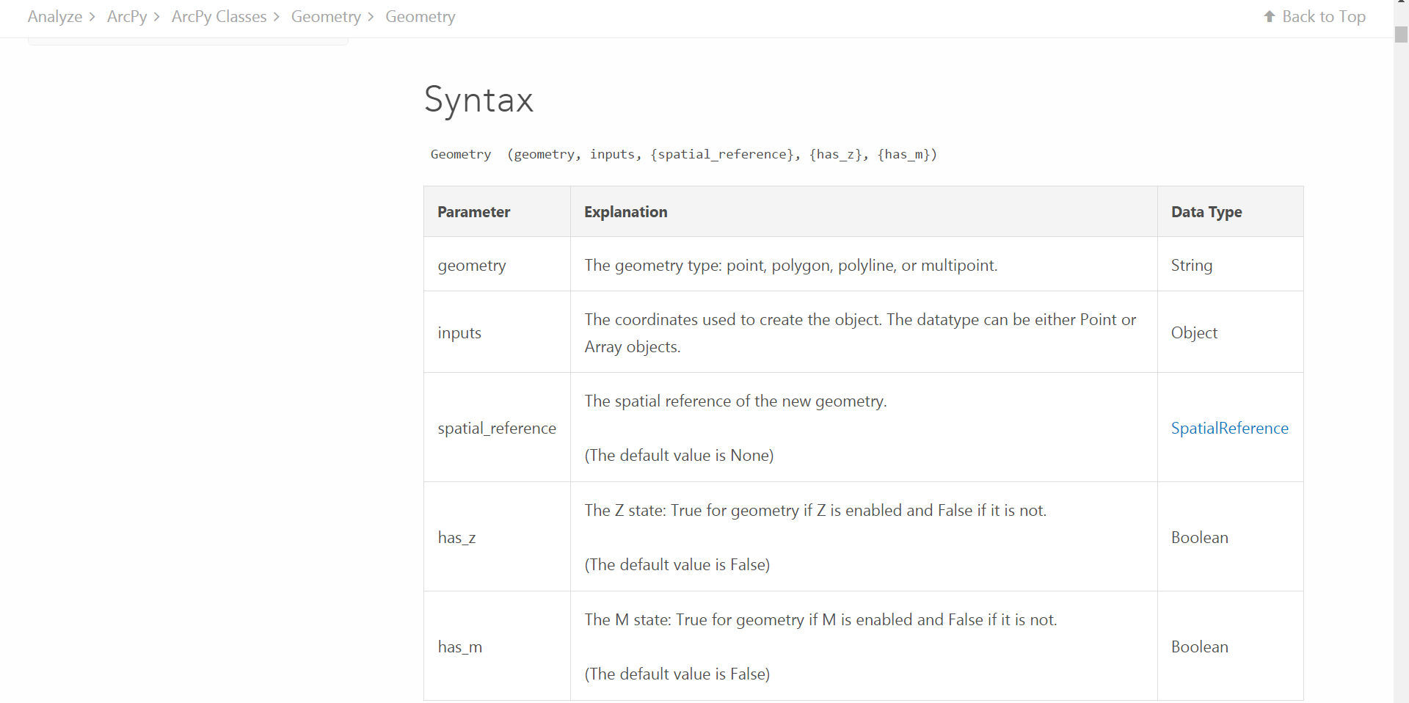
Geometry Class
http://desktop.arcgis.com/en/arcmap/10.3/analyze/arcpy-classes/geometry.htm

Slide 13
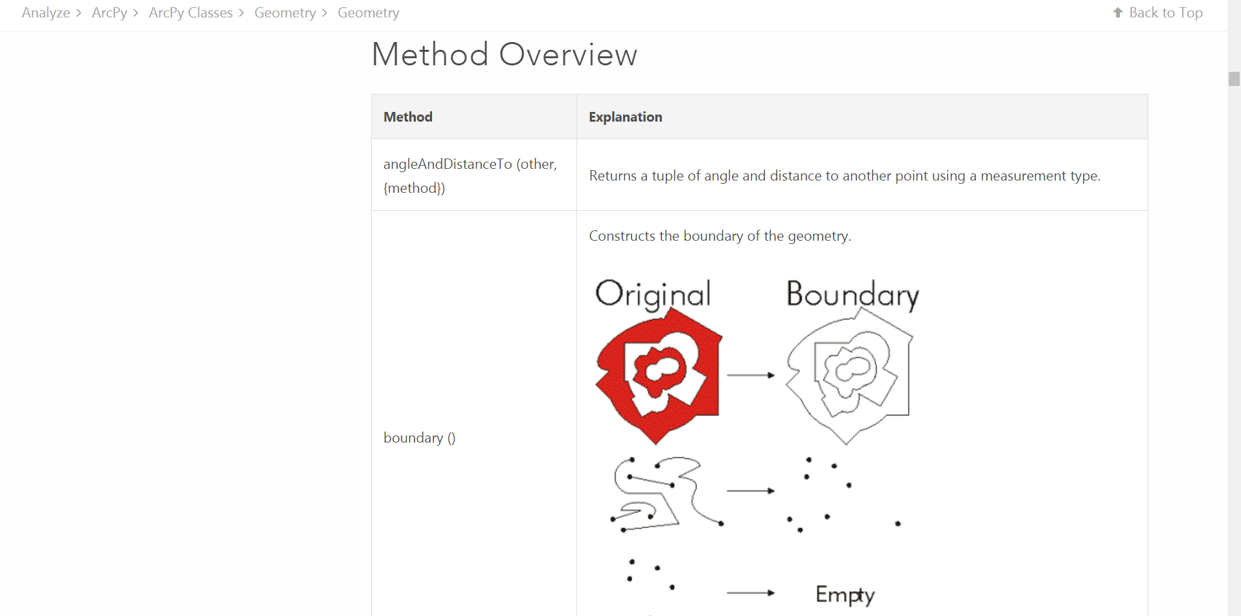
Geometry Methods
http://desktop.arcgis.com/en/arcmap/10.3/analyze/arcpy-classes/geometry.htm#M1_GUID-BC466D06-360C-42BD-B198-DA4139B45F49

Slide 14
ArcPy Geometry Demo

